Slide 1
Data Science CSCI 3320 Project: Fertility Rate 1960-2020
$Student 1:{ Mahmoud Z. Abu Sultan , ID: 120201068 };
$Student 2:{ Ahmad Al Nahal , ID: 120202122 };

Slide 2
Data mining About the domain:Business Understanding.

Slide 3
About the domain ...
Fertility rate from 1960 to 2020, that is, the average fertility rate during each of those years for each country in the world.
That is, the fertility rate is refers to the average number of children that mothers give birth to during their childbearing years.
The fertility rate for each year is calculated based on the total number of births per woman during the year.
From the general proportion of total births in one country, the average fertility rates of women in the country are obtained.
It is an important indicator that reflects the fertility level of the population, and thus the population growth can be predicted.

Slide 4
About the domain.
All of this is assuming no net migration and an unchanged(fixed) mortality rate.
All in line with prevailing fertility rates by age.
Fertility rate is also an indicator of population growth.
It all shows the extent of the impact of development on fertility rates, taking into account the number of deaths.

Slide 5
Data mining About the data:Data Understanding.

Slide 6
About the data...
The Dataset for: Fertility Rate of 186 Countries in 1960-2020.
The fertility rate is usually expressed as the number of births per 1,000 women of childbearing age.
The age of women is usually defined as ranging from 15 to 49 years.
A fertility rate of 2.1 is considered the replacement level.
Which means that each woman has on average enough children to replace herself and her partner.
Fertility rate above replacement level may indicate population growth.
While the fertility rate is below replacement level may indicate population decline.

Slide 7
Data Exploration to Data Preparation Data Exploration

Slide 8
Data exploration...
Represented in 188 rows and 62 columns.
where the rows(186) represent the countries and their fertility rates.
Where there is a row(1) representing the fertility rate in percentage for the whole world during each year.
And the columns(61) represent the years.
There are no missing values. According to the current dataset from the source (kaggle.com), the ratio is (0%).

Slide 9
Data exploration...
Useing descriptive statistics:
The standard deviation, mean, mediand an provide a quick overview of the central tendency of the data and the diversity of the data.
The following values ​​are calculated as a percentage of the total fertility rate in the worldfor 61 yers , 186 countres:
Mean = 3.44360
Median = 3.32
Range (2.39 - 4.98) = 2.59
Standard Deviation = 0.93
Data visualization: -> in next page ...

Slide 10
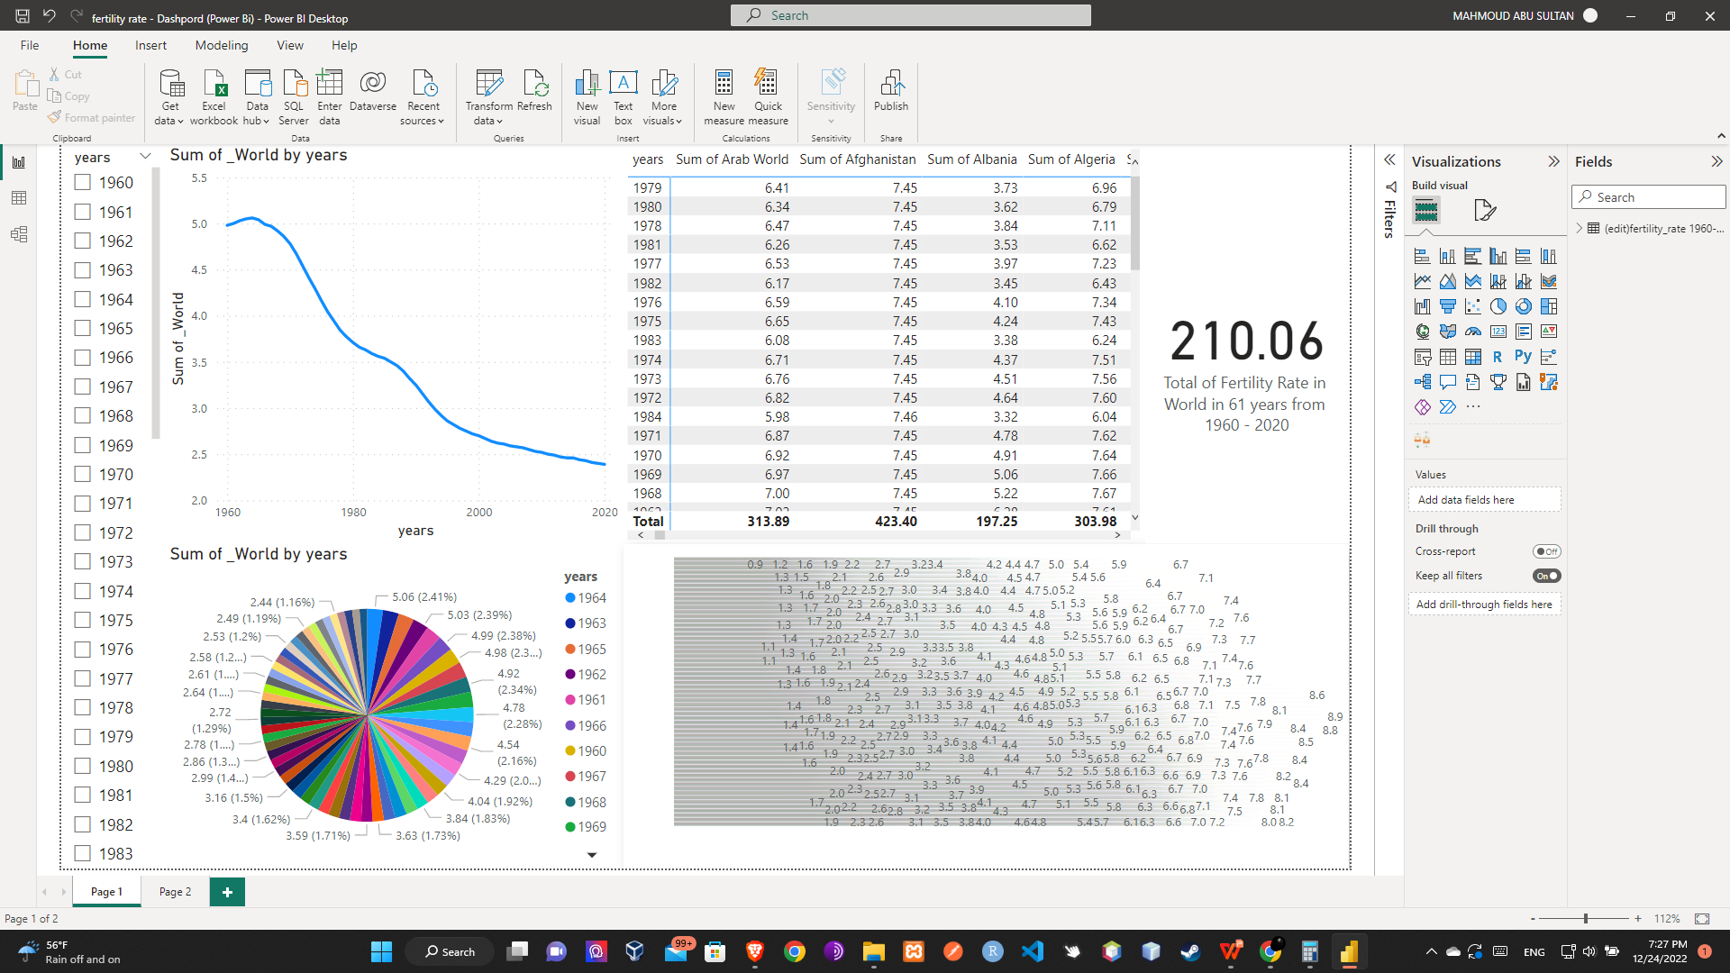
Data exploration... Dashboard

Slide 11
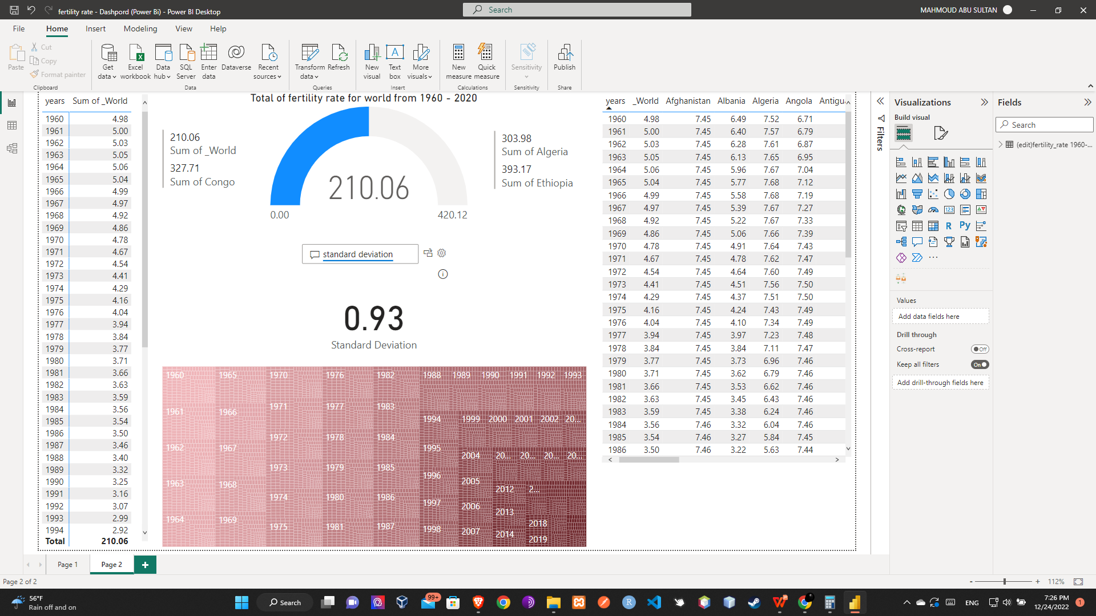
Data exploration... Dashboard

Slide 12
Data exploration. Tell a story about what happened?
The world has experienced a drastic decline in fertility rates from 1960 to 2020.
Where the highest height reached was 5.06 in 1964.
The Arab countries were the largest contributors to this increase, as the fertility rate reached 7.05 in 1964.
South Korea is the country with the lowest fertility rate from 1960 - 2020 estimated at 0.9 .
Rwanda is the country with the highest fertility rate from 1960 - 2020 estimated at 8.9 .

Slide 13
Data Preparation

Slide 14
Data preparation.
The data should be cleaned by deleting duplicate data.
Duplicate in the Sudan data column.
Replace empty cells with intermediate values ​​or a value proportional to the string.
Processing and repairing Missing data.part
Since we are working on time series, we will split data based on time.
We will use the data from the first half of the dataset for training ,
And the data from the second half of the dataset for testing.
Part | # of records | 000%
Train | 30 | 50%
Test | 30 | 50%

Slide 15
Business Analytics Descriptive Analytics

Slide 16
Descriptive analytics... what happend? - what is happening?
Fertility rates have decreased dramatically from 1960 to 2020.
There is an increase in fertility rates at 1964 cents.
The data is sufficient to obtain valid forecasts.

Slide 17
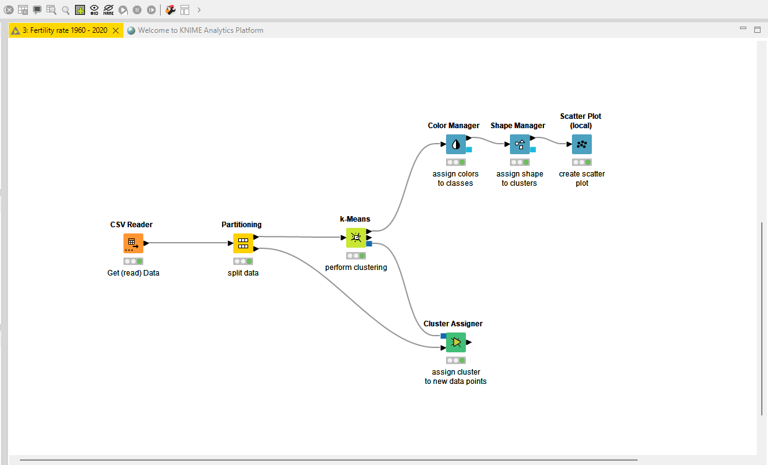
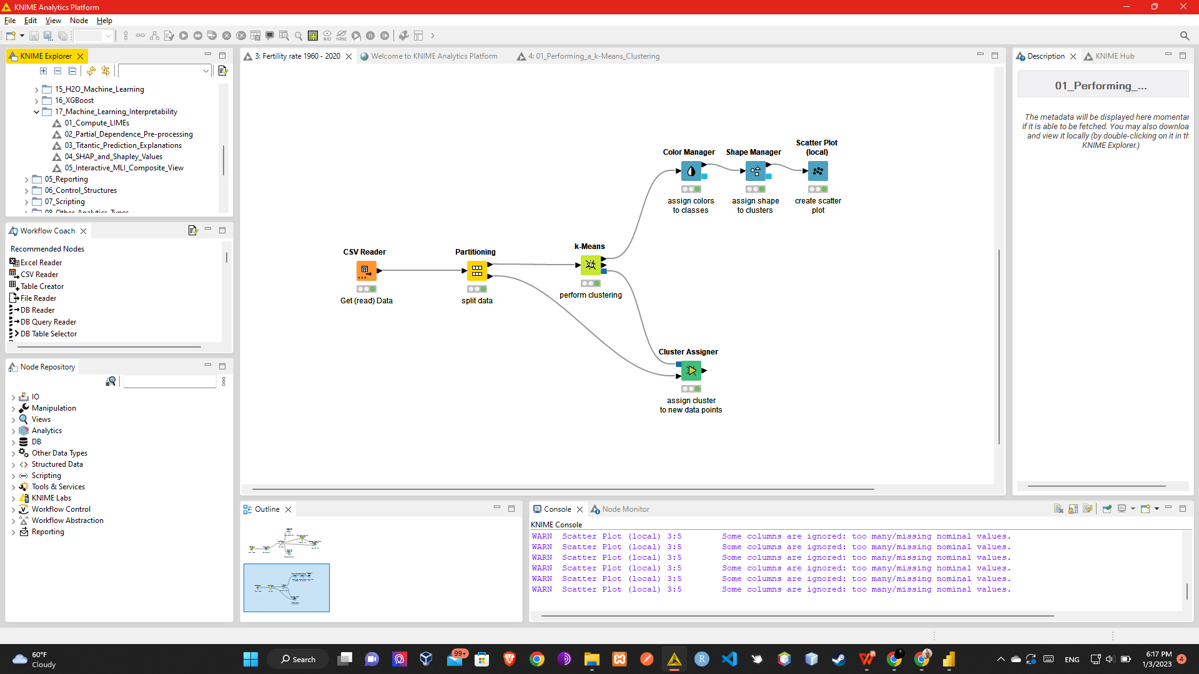
Descriptive analytics. Use clustering to describe the data

Slide 18
Business Analytics Predictive Analytics

Slide 19
Predictive analytics... what will happen? - why will it happen?
Fertility rates are predicted for 2021.
The results were acceptable and in line with the time series.
There will be an increase in fertility rates for the year 2021.

Slide 20
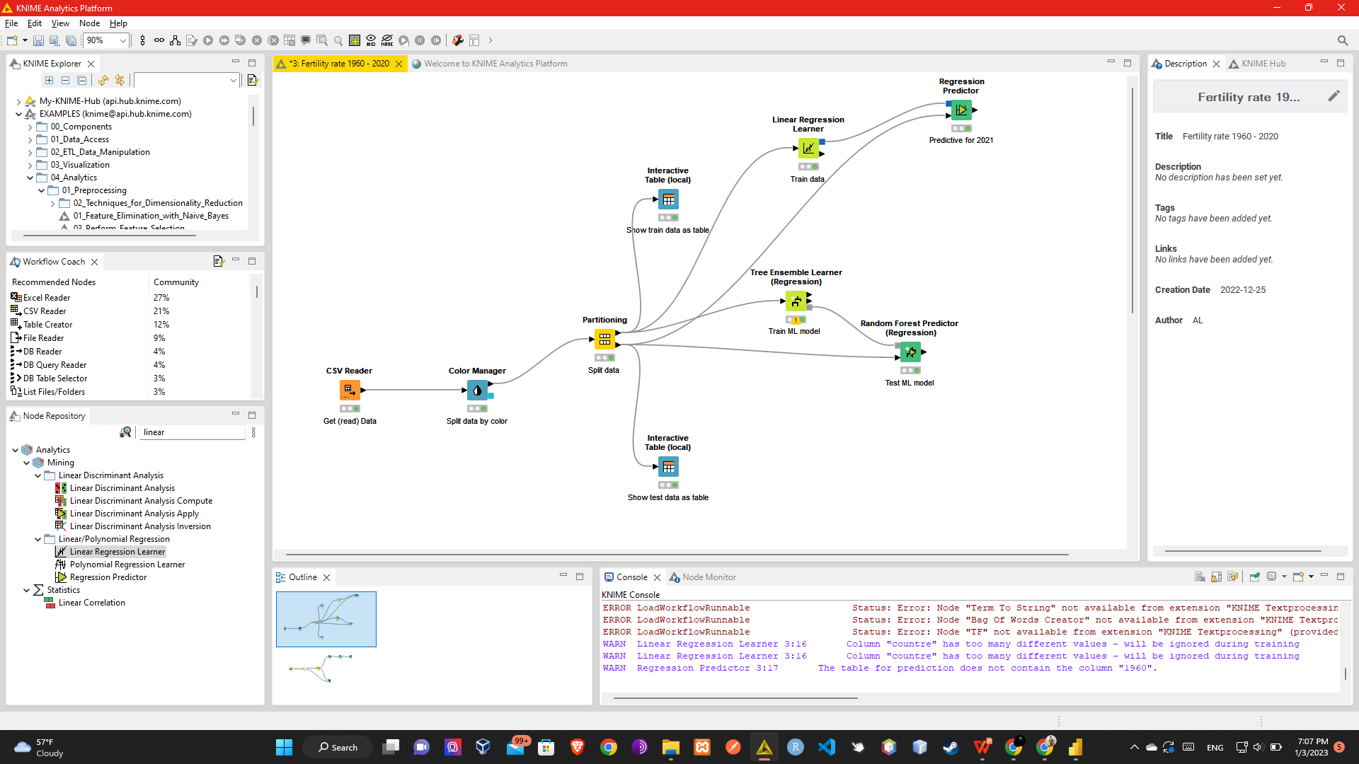
Predictive analytics. Use machine learning models to predict the future

Slide 21
Conclusions.
Summarize your conclusions
Only one slide

Slide 22
☺
7M.T

